Slide 1





TLIQ
HARDWARES
CONSUMER GOODS
Ad_Hoc Insights
AV
CREATED BY
V.ARUN KUMAR

Slide 2
TLIQ
HARDWARES
Agenda
1
Company Details
About Atliq Hardwares Company Details
Problem Statement
2
Identify the challenges faced by Atliq Hardwares(Imaginary Company), a leading computer hardware producer, and how data analysis can help solve them.
3
Project Overview
Define the objective, focus, and data sources for the analysis, including the specific datasets, data corrections, and hardware considerations.
Ad-Hoc-Requests
4
Explore a series of data analysis requests that simulate real-world inquiries from stakeholders, highlighting the power of data to answer specific questions.

Slide 3
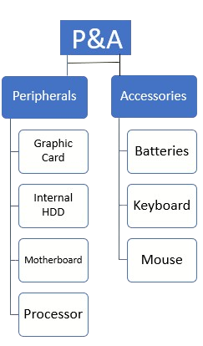
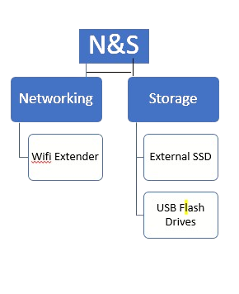
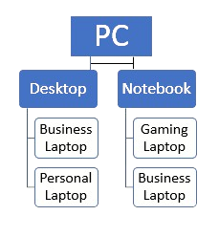
TLIQ
HARDWARES
Company Details
AtliQ Harwares(Imaginary Company) Is a Computer Hardware and Accessories Manufacture
FISCAL YEAR
ATLIQ’S PRODUCTS
FY_2020
SEPTEMBER(2019)-AUGUST(2020)
FY_2021
SEPTEMBER(2020)-AUGUST(2021)

Slide 4

TLIQ
HARDWARES
Problem Statement
1
Data-Driven Decisions
Atliq Hardwares, a leading computer hardware producer, lacks the necessary data insights to make informed, timely decisions.
2
Expanding Data Analytics Team
2
The company plans to expand its data analytics team by hiring junior data analysts skilled in both technical and soft skills.
3
SQL Challenge
Tony Sharma, the data analytics director, designed a SQL challenge to assess both technical and soft skills in potential candidates.
4
Role of Data Analyst
As a Data Analyst I to examine data to uncover significate insights and explore themes.

Slide 5

TLIQ
HARDWARES
Project Overview
Objective
Focus
Conduct a comprehensive analysis of Atliq Hardwares' datasets to uncover key insights and support data-driven decision making.
The analysis focuses on fact_forecast_monthly, fact_sales_monthly, post_invoice_deduction, and pre_invoice_deduction datasets, with a focus on customer, market, product, manufacturing cost, and gross price data.
Data Sets
Data Corrections
Analyze the ad-hoc requests, providing outputs based on the datasets mentioned above, focusing on providing detailed information about customer, market, product, manufacturing cost, and gross price.
Ensure data quality by removing leading and trailing spaces and addressing duplicate data entries or names, enhancing data consistency and reliability.

Slide 6

Ad-Hoc-Requests
The ad-hoc requests are a series of questions that simulate real-world data analysis scenarios. These questions will help us understand the data and extract valuable insights.

Slide 7
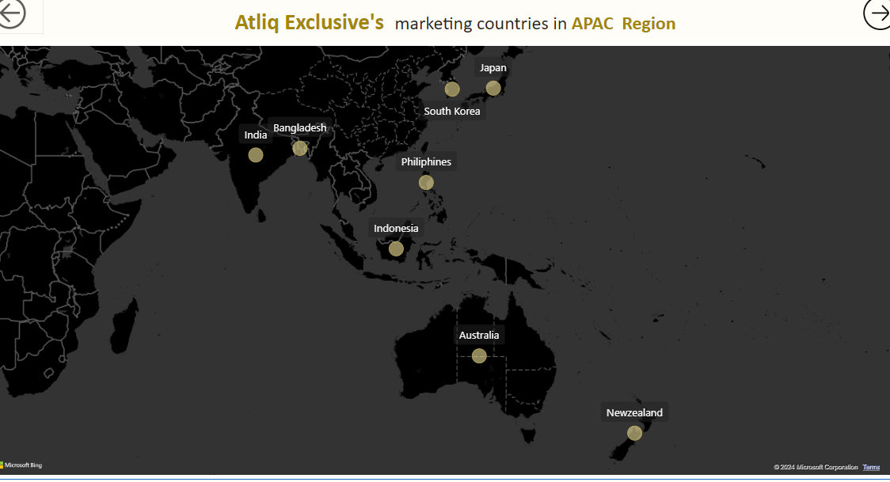
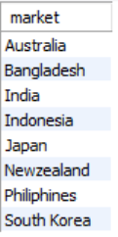
Q1: Atliq Exclusive's Markets
Provide the list of markets in which customer "Atliq Exclusive" operates its business in the APAC region.
Request:

Slide 8
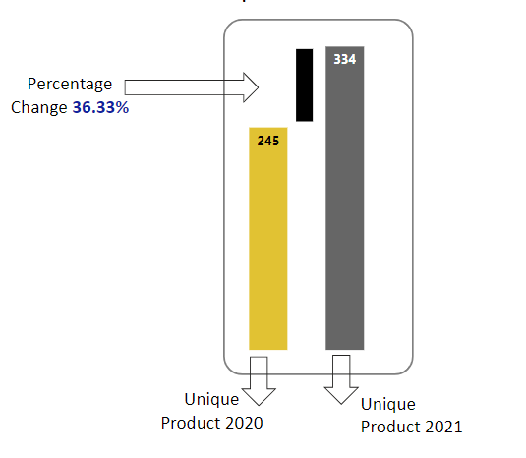
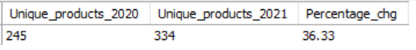
Q2: Unique Product Increase
Request:
What is the percentage of unique product increase in 2021 vs. 2020? The final output contains these fields, unique_products_2020 unique_products_2021 percentage_chg
Unique Products in 2020-245
Unique Products in 2021-334
Percentage Change-36.33%

Slide 9
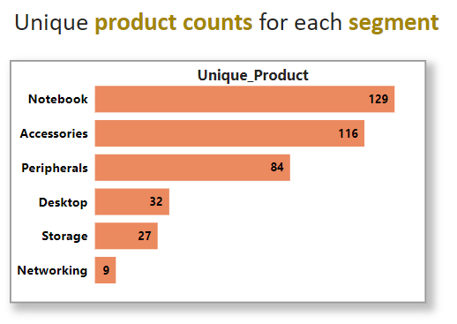
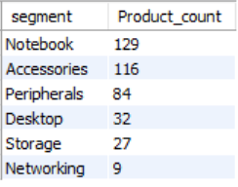
Q3: Product Counts by Segment
Provide a report with all the unique product counts for each segment and sort them in descending order of product counts. The final output contains 2 fields
segment
product_count
Request:
Top Segment Notebook with 129 Products
Last Segment Networking with 9 Products

Slide 10
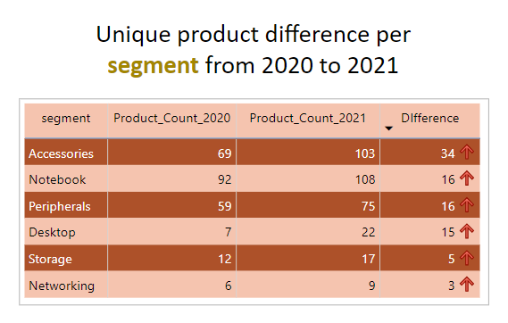
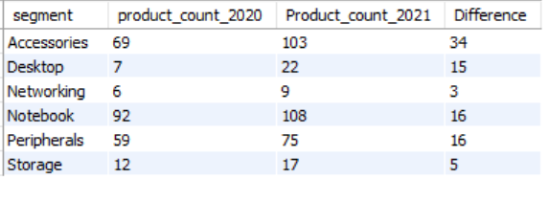
Q4: Segment with Highest Increase
Which segment had the most increase in unique products in 2021 vs 2020? The final output contains these fields, segment product_count_2020 product_count_2021 difference
Request:
Top Segment Accessories with 34 Difference
Last Segment Storage with 5 Difference

Slide 11
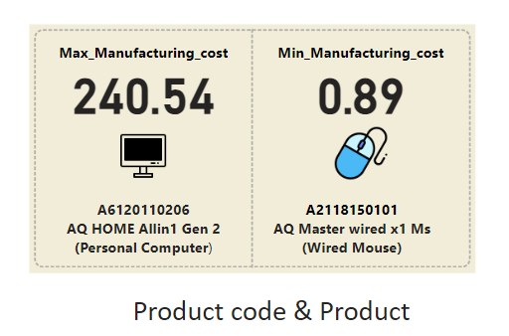
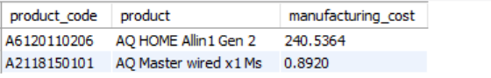
Q5: Highest & Lowest Manufacturing Costs
Get the products that have the highest and lowest manufacturing costs. The final output should contain these fields, product_code product manufacturing_cost
Request:
Personal Computer has Highest Manufacturing Cost
Wired Mouse has Lowest Manufacturing Cost

Slide 12
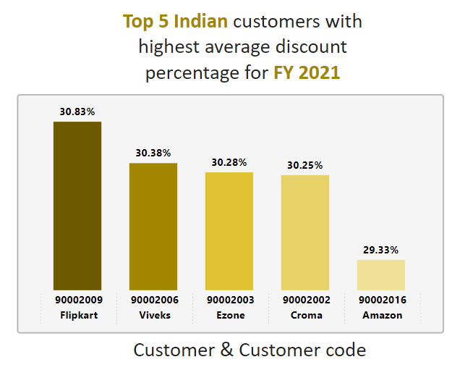
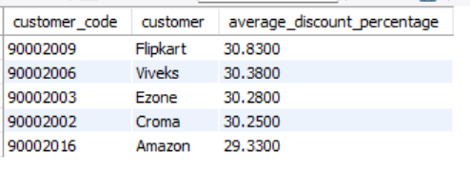
Q6: Top 5 Indian Customers
Generate a report which contains the top 5 customers who received an average high pre_invoice_discount_pct for the fiscal year 2021 and in the Indian market. The final output contains these fields, customer_code customer average_discount_percentage
Request:
Flipkart has Highest Average Discount Percentage
Amazon has Highest Average Discount Percentage

Slide 13
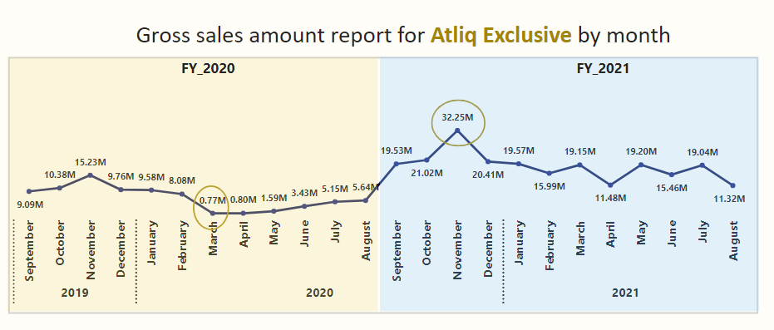
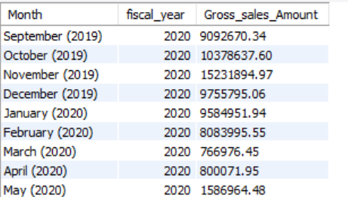
Q7: Atliq Exclusive’s Gross Sales Amount
Get the complete report of the Gross sales amount for the customer “Atliq Exclusive” for each month. This analysis helps to get an idea of low and high-performing months and take strategic decisions. The final report contains these columns: Month Year Gross sales Amount
Request:
2020 November Have Highest Gross Sales Amount with 32.25M
2020 March Have Lowest Gross Sales Amount with 0.77M

Slide 14
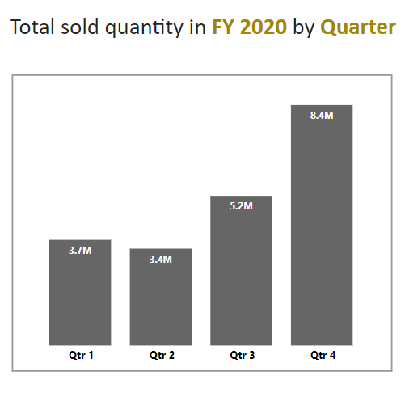
Q8: Total Sold Quantity by Quarter
. In which quarter of 2020, got the maximum total_sold_quantity? The final output contains these fields sorted by the total_sold_quantity, Quarter total_sold_quantity
Request:

Slide 15
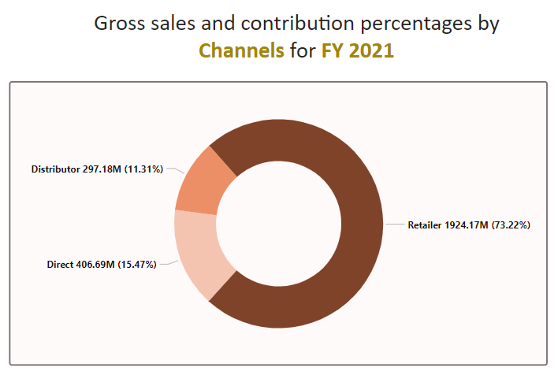
Q9: Gross Sales Amount By Channel
Which channel helped to bring more gross sales in the fiscal year 2021 and the percentage of contribution? The final output contains these fields, channel gross_sales_mln percentage
Request:
Retailer Have Highest Gross Sales Contribution with 1924.17M(73.22%)
Distributer Have Lowest Gross Sales Contribution with 297.18M(73.22%)

Slide 16
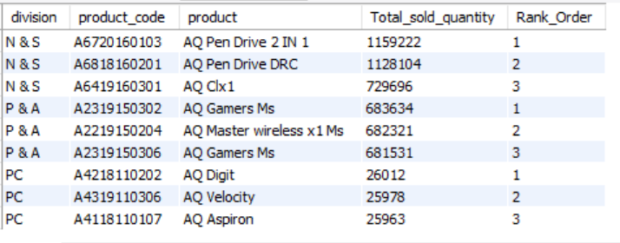
Q10: Top 3 Products by Division
Get the Top 3 products in each division that have a high total_sold_quantity in the fiscal_year 2021? The final output contains these fields, division product_code codebasics.io product total_sold_quantity rank_order
Request:

Slide 17
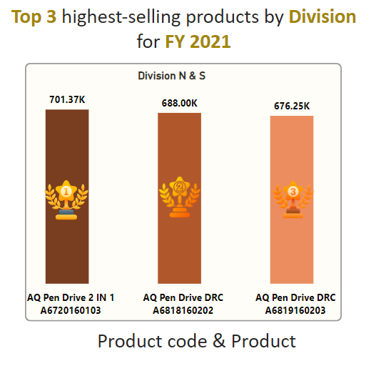
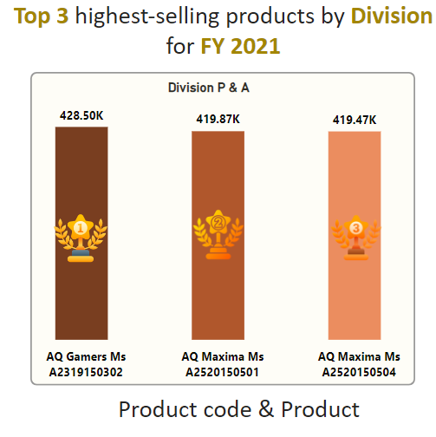
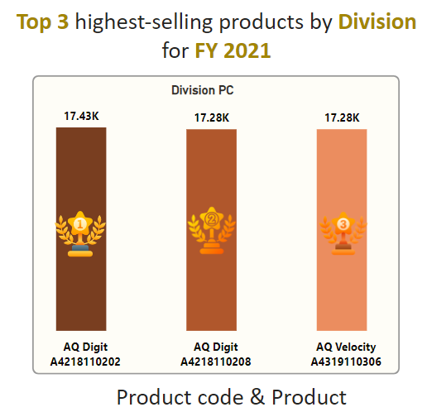
Q10: Top 3 Products by Division

Slide 18


TLIQ
HARDWARES
Thank You
HEMANAND SIR
DHAVAL PATEL SIR

